Slide 1


The Big Leap: From Academic to Industry
Go Frendi Gunawan,
Lecturer at STIKI Malang,
Backend Engineer at Kata.ai

Slide 2
Before We Start
Goal
  Getting insight of academic environment
  Getting insight of industry environment
  Getting ideas to overcome difficulties (if any)
Non Goal
  Sparking flame wars between academic and industry

Slide 3
But I love war anyway :)
Academic
Non profit?
Theoritical
Process Oriented
Industry
Profit oriented
Practical
Product Oriented

Slide 4
Academic
Teaching – Research - Service

Slide 5
What Lecturers Do
Teaching: Obviously
Research: Published Paper
Service: Contributing to Society

Slide 6

The Regulator

Slide 7
It Should be Good,
Right?

Slide 8
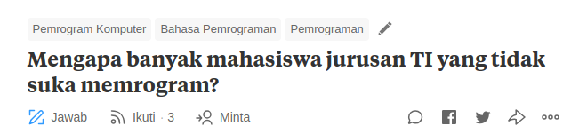
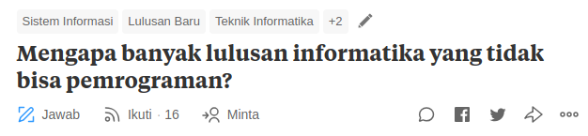
But Why...

Slide 9


Because...
Student Factor
  No clear purpose
  School != Work
  Tech Job == Low Level
Teacher Factor
  Lack of skill (Technical/Communication)
  Wrong Metrics
Society Factor
  Socio Cultural (Especially for Female)

Slide 10
Because...
Student Factor
  No clear purpose
  School != Work
  Tech Job == Low Level
Teacher Factor
  Lack of skill (Technical/Communication)
  Wrong Metrics
Society Factor
  Socio Cultural (Especially for Female)

Slide 11
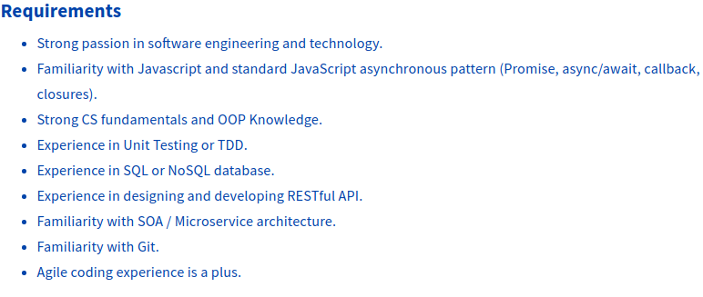
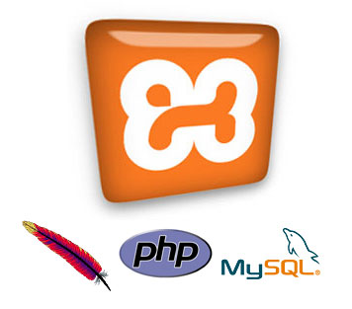

Likely True
YES PASSION IS MANDATORY
WHAT THEY NEED
WHAT YOU LEARN

Slide 12
So, If You are a
Teacher
Improve your skillset
  Do projects
  Join Industry
Let DIKTI do their job
But please, do your job
Student
Find your goal
  Stick with it
Improve your skillset
  Learn how to learn
  Why before how

Slide 13
So, If You are a
Teacher
Improve your skillset
  Do projects
  Join Industry
Let DIKTI do their job
But please, do your job
Student
Find your goal
  Stick with it
Improve your skillset
  Learn how to learn
  Why before how
JOIN FACEBOOK
DEVELOPER CIRCLE
And other communities :)

Slide 14
Industry
Whatever – Problem Solving - Money

Slide 15
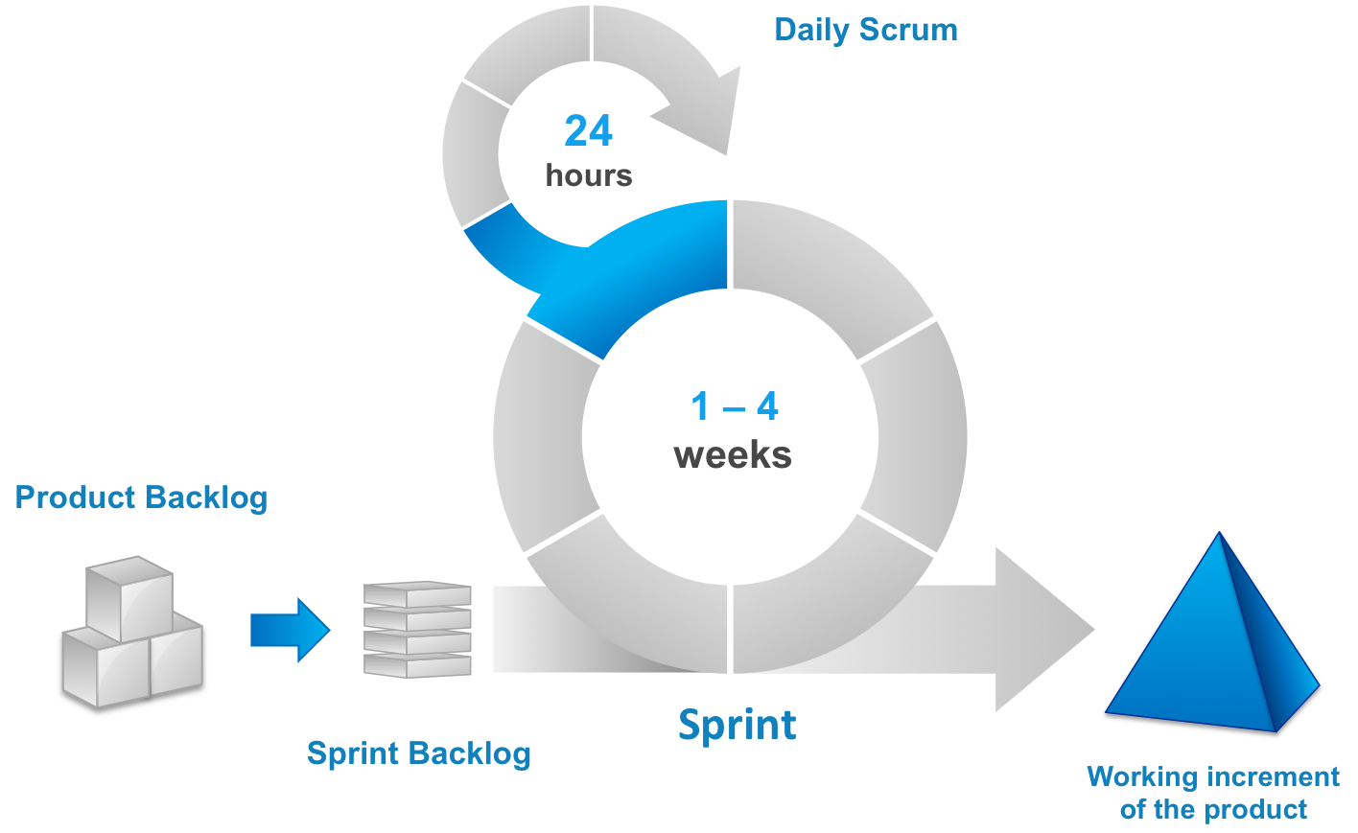
What Engineers Do
Meeting
Planning
Coding
Reviewing
Discussing

Slide 16

What Engineers Do
Meeting
Planning
Coding
Reviewing
Discussing
Rediscovering Vitas
Taking Screenshots

Slide 17

Our Achievements

Slide 18

Technology We Use
Slack
Sleekr
Quip
Jira
Bitbucket
Microsoft Azure

Slide 19
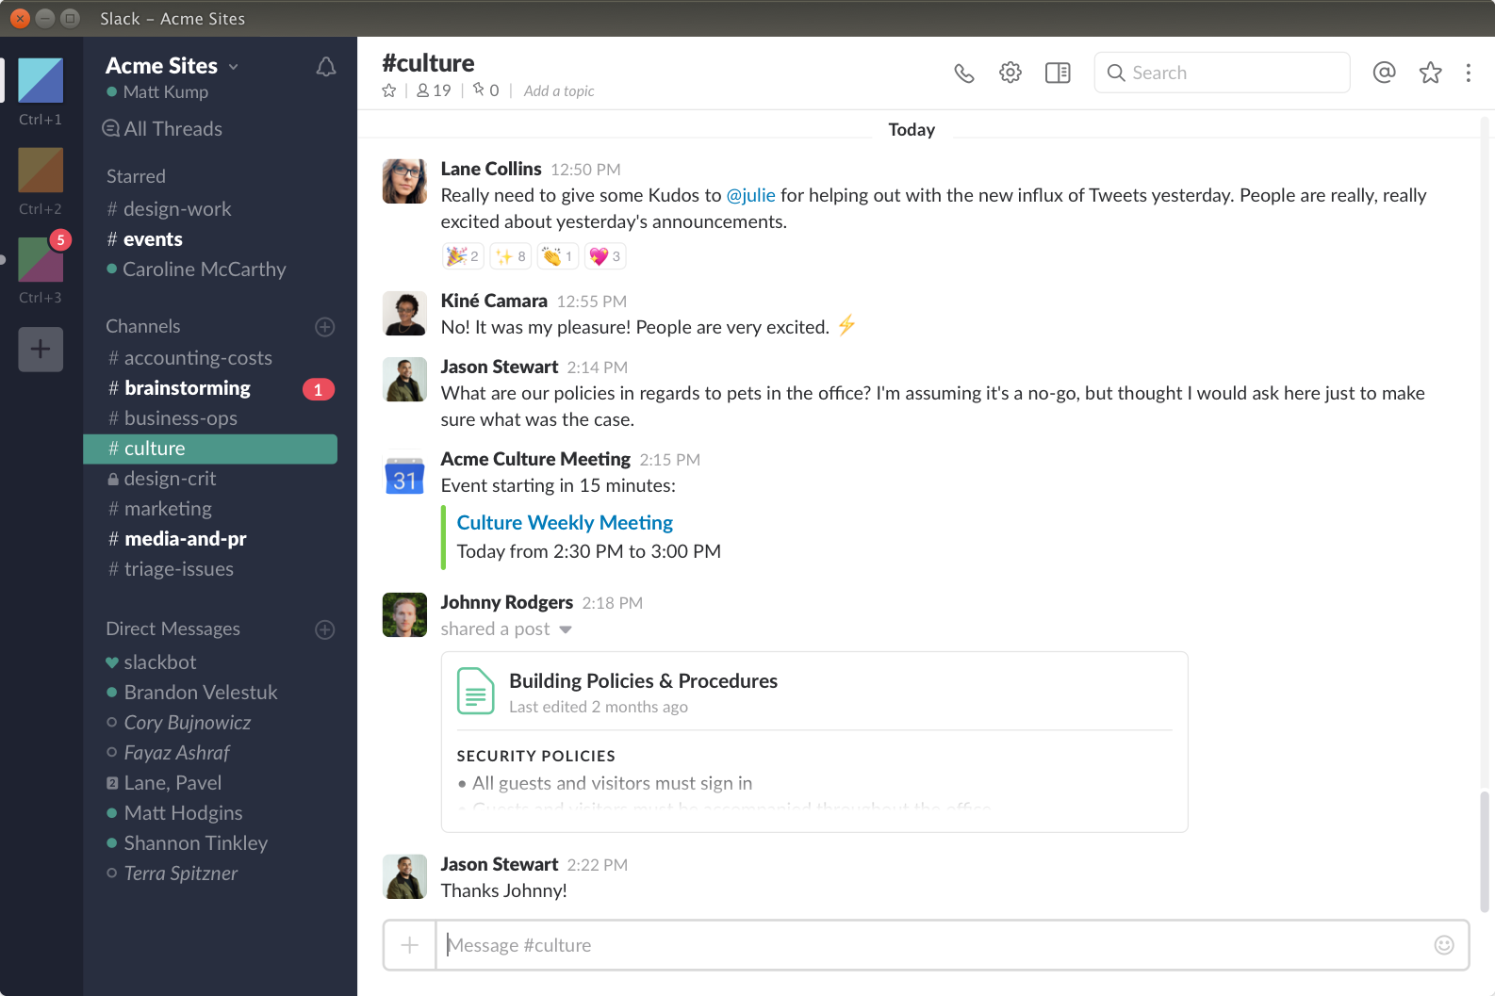
Slack

Slide 20
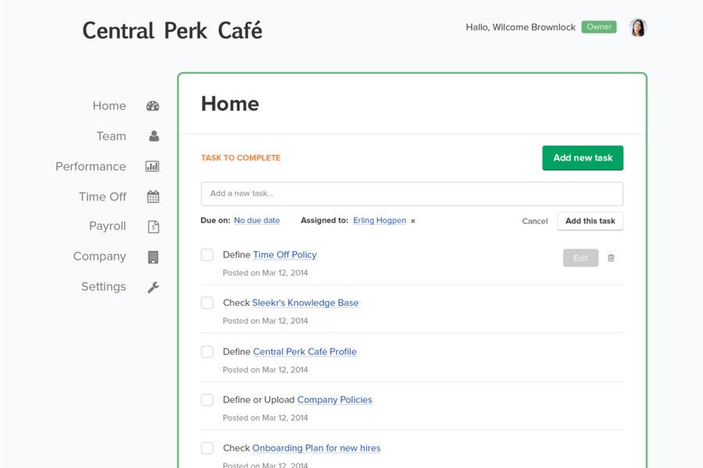
Sleekr

Slide 21
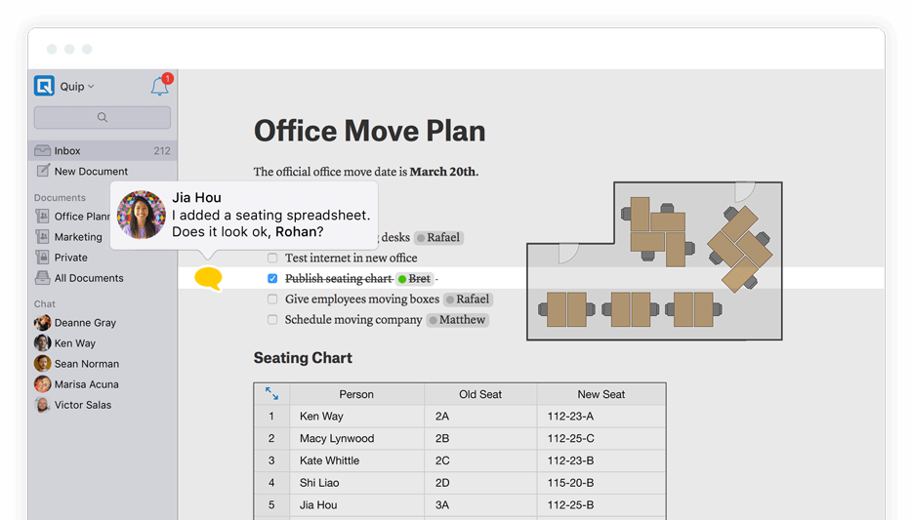
Quip

Slide 22
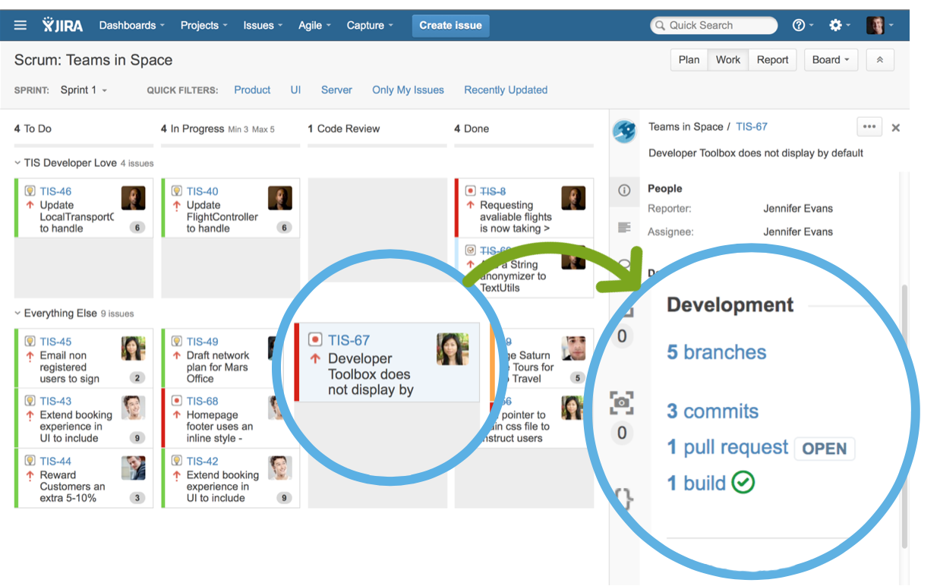
Jira

Slide 23
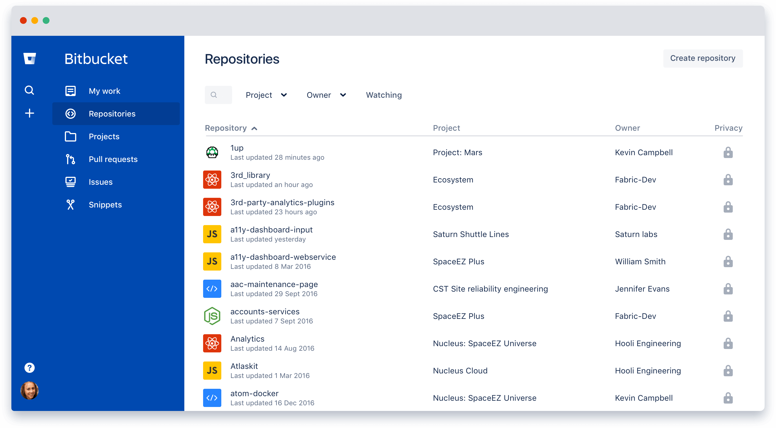
Bitbucket

Slide 24

Our Architecture
Microservices
  Mostly Node.Js
  Some Python
  Soon Golang
RDBMS
  MySQL
No-SQL
  MongoDB
  Cassandra
  ElasticSearch
CI/CD
  Bitbucket Pipeline
  Kubernetes
  Docker
  SSH + VM :(

Slide 25

My Contribution
Moleculer-X: Moleculer + Merapi
  POC
  Not a good idea
Nightwatch: Slack-bot for NLU Training Job Monitoring
Merapi-plugin-service-rabbit
Katabatic: On-premise Runner
Split NLU Service (on progress)
Cultural influences: memes,
slack stickers

Slide 26
What I Learn
Typescript
Golang
Docker
  I use docker in my machine :)
  I build my own docker image :)
Bitbucket pipeline
Kubernetes
I have deploy a service :)
In the wrong cluster :(
Dependency Injection
  No, it is not the holy grail of everything
Clean(er) Code
Most problem can be solved by adding abstractin layer
Or ditch it out

Slide 27
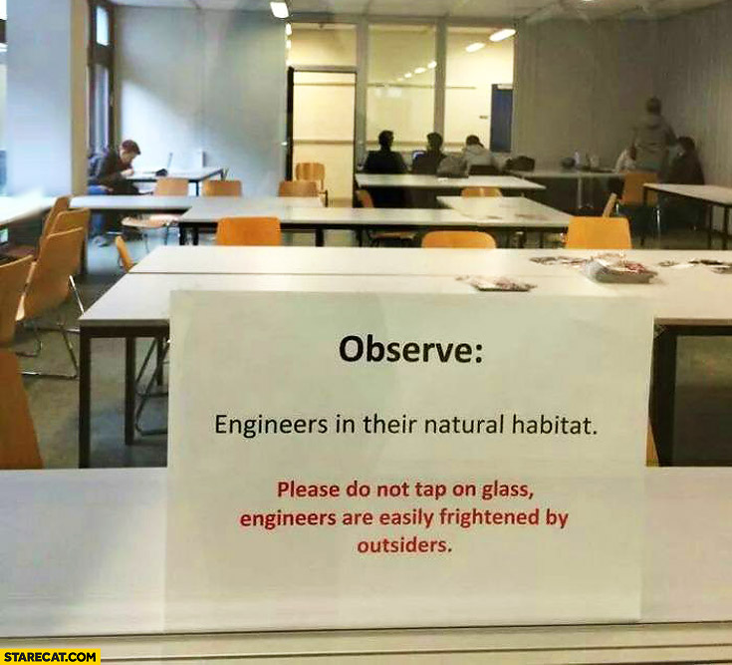
So, If You are an Engineer
Yes, you are awesome
Okay, sometime you are sucks
But you are still awesome
Share your experience
  Write articles
  Be speaker
  Teach :)

Slide 28
So, If You are an Engineer
Yes, you are awesome
Okay, sometime you are sucks
But you are still awesome
Share your experience
  Write articles
  Be speaker
  Teach :)
JOIN FACEBOOK
DEVELOPER CIRCLE
And other communities :)

Slide 29
Finally
How do I Survive?

Slide 30

Full time lecturer
Full time engineer
8 hours + 8 hours = 16 hours
  No, not that extreme
  Well, sometime it is
Prioritize your goals
  Be very clear about what you want
  Ticktick.com
Delegate tasks
Ask for help

